Slide 1
Spring Boot Interview Questions
Sanjay Degaonkar

Slide 2
How many attempts made by Thomas Edison to invent the bulb?
1000
When a reporter asked Edison how it felt to fail 1,000 times
Edison replied: “I didn't fail 1,000 times. The light bulb was an invention of 1,000 steps.”

Slide 3
How many attempts do you require to clear interview?
Believe in first select only ☺

Slide 4
Smart way to crack interview in first attempt?
Wide and Intelligent set of questions.
Cover the questions on REST, Global Exception Handler, Spring Data JPA, Spring Boot Testing, Security, filtering, swagger, actuator, versioning and content negotiation, Transaction Management, Asynchronous communication, RestTemplate, WebClient, Profile, Autoconfiguration, Multithreading & design patterns.
Practical Material to understand all interview questions
https://github.com/sanjaydegaonkar/springboot
Scenario based questions, use case(beyond syntax)
Study material – official docs
3 Important tips to clear interview ☺

Slide 5
Spring Boot Features
Standalone application (container inside app)
Autoconfigured (e.g. MVC – DispatcherServlet, ORM – DataSource and TransactionManager)
Provide opinionated 'starter' POMs to simplify your Maven configuration(No problem of version compatibility)
Provide production-ready features such as metrics, health checks and externalized configuration
Absolutely no code generation and no requirement for XML configuration
Focus more on business features and less on infrastructure

Slide 6

@SpringBootApplication
Combination of 7 annotations.
@Documented
@Inherited
@Target
@Retention
@SpringBootConfiguration
@AutoConfiguration
@ComponentScan

Slide 7
Default server name?
Tomcat
Other embedded server(Jetty, Undertow)

Slide 8
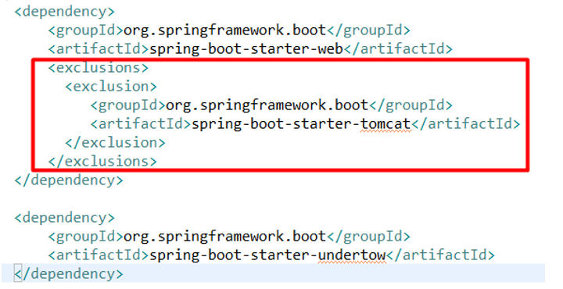
How to configure undertow ?

Slide 9
@Controller vs @RestController
@ResponseBody + @Controller

Slide 10
@RequestMapping vs @GetMapping
The @GetMapping is a shortcut for @RequestMapping(method = RequestMethod.GET)
@PostMapping
@DeleteMapping
@UpdateMapping

Slide 11
In which http methods require @RequestBody
Post
Put

Slide 12
Return type Optional Object?
This class has various utility methods to handle values ‘available/not available’ instead of checking null values.

Slide 13
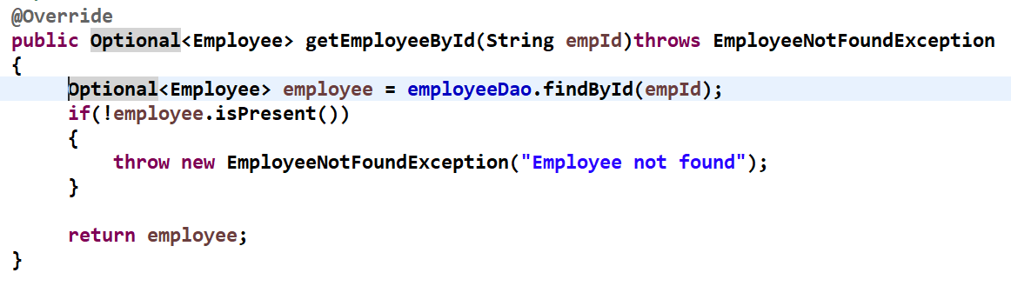
Optional Object sample code

Slide 14
@PathVariable vs @RequestParam
@PathVariable ex. http://localhost:8080/employee/1
@RequestParam ex. http://localhost:8080/employee?empId=1

Slide 15
In Which Layer @Component can be used ?
In any layer (DAO, Service, Controller…)

Slide 16
JpaRepository vs CrudRepository
Jparepository
CrudRepository
Jparepository ->PagingAndSortingRepository ->CrudRepository
Provides additional facilities of paging and sorting apart from CRUD operations.
findAll() ->return type List<T>
Base interface
Provides facility of basic CRUD operations
findAll() -> return type Iterable<T>

Slide 17
Use case for Unidirectional and Bidirectional mapping
How do you want to traverse the data?
Employee has Address (one-to-one)
User has Orders(one-to-many)

Slide 18
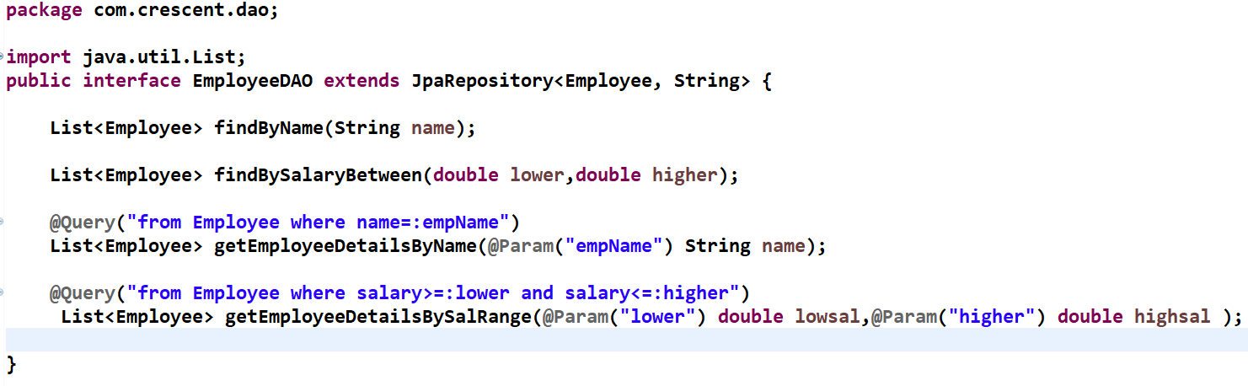
How to write down custom queries?

Slide 19
What is Profile ?
A profile is a set of configuration settings.
Spring Boot allows to define profile specific property files
application-dev.properties, application-stage.properties , application-prod.properties or
Single yml file to define all the environment specific configurations

Slide 20
Properties vs Yml
Properties
yml
Key/value(Map) and String types
Used primarily in Java language
Non hierarchical
Works with @PropertySource
One Spring Profile per config
Key/value(Map), Lists and scalar types
Used in many lang(Ruby,Python,Docker)
Hierarchical
Doesn’t work with @PropertySource
Multiple Spring profile per config

Slide 21
Which is better way to configure ?Properties or YAML
YAML offers many advantages over properties files
More clarity and better readability
Support for maps, lists, and scalar types
Can include several profiles in the same file
YAML comes with hierarchical nature which helps in avoiding repetition

Slide 22
What is Actuator ?
Production ready features
Health, Info, mappings, beans, metrics

Slide 23
What is Thymeleaf?
Offers elegant and natural templates for a web application.
Ideal for HTML5,CSS Java Web applications.

Slide 24
Tell me about auto configuration in Spring Boot ?
Spring Boot automatically configures beans.
E.g
If we make use of Spring JDBC, the spring boot autoconfiguration feature automatically registers the DataSource and JDBCTemplete bean.
This entire process of automatically declaring the framework specific bean without the need of writing the xml code or java config code explicity is called Autoconfiguration which is done by springBoot with the help of an annotation called @EnableAutoconfiguration

Slide 25
How to enable autoconfiguration report?
debug=true (application.properties)
logging.level.root=debug (application.properties)
Java –jar demoproject.jar –debug (command line)
Many more !

Slide 26
How to disable a specific autoconfiguration?
@EnableAutoConfiguration(exclude={SomeAutoConfig.class}) //above the class OR
@EnableAutoConfiguration(excludeName={“a.b.SomeAutoConfig”}) OR
@SpringBootApplication(exclude = { SomeAutoConfig.class })

Slide 27
Can we have autoconfiguration based on condition?
Yes
Presence/Absence of Bean
Presence/Absence of Property
Presence/Absence of Jar

Slide 28
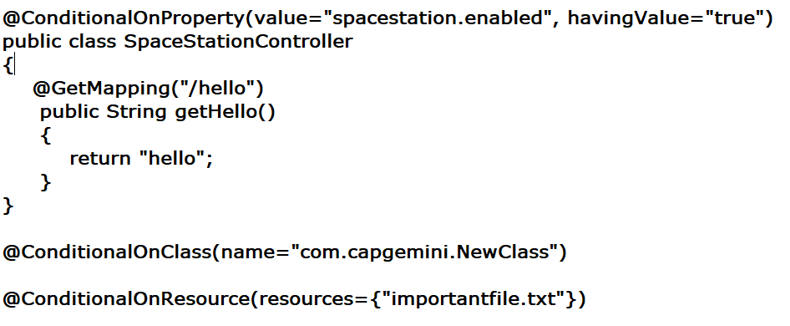
Sample code for ConditionalOnProperty

Slide 29
How to add filter in your app ?
By implementing Filter interface
Using FilterRegistrationBean
Using MVC controller

Slide 30
Have you used swagger in your project?
To Develop API
Interact with API
Document APIs

Slide 31
Transaction Propagation?
REQUIRED(Default)
SUPPORTS
NOT_SUPPORTED
REQUIRES_NEW
NEVER
MANDATORY

Slide 32
Tell me your experience on how you handled exception in Spring Boot ?
ResponseStatusException class (Spring 5)
fast way for basic error handling in RESTful APIs (Good for small projects/POC)
ResponseEntity, UriComponentBuilder – status and header info (Spring 5)
@RestControllerAdvice and @ExceptionHandler

Slide 33
Most important tips ☺
Source Code to understand internal working
Did you check any source code to understand internal working ?
DevOps
Did you build your project using any build server (Jenkins Server) ?
Cloud
Did you deploy your application using GKE or AKE

Slide 34
Happy Learning ☺
Thanks ☺
Subscribe channel to get latest and greatest update in technology ☺

